Slide 1

Chapter 10
Simple Linear Regression

Slide 2
Contents
Simple Linear Regression Model
Least Squares Method
Coefficient of Determination
Model Assumptions
Testing for Significance
Estimation for β1
Confidence interval & Prediction interval estimation

Slide 3
Simple Linear Regression
Managerial decisions often are based on the relationship between two or more variables.
Regression analysis can be used to develop an equation showing how the variables are related.
The variable being predicted is called the dependent variable and is denoted by y.
The variables being used to predict the value of the dependent variable are called the independent variables and are denoted by x.

Slide 4
Simple Linear Regression
Simple linear regression involves one independent variable and one dependent variable.
The relationship between the two variables is approximated by a straight line.
Regression analysis involving two or more independent variables is called multiple regression.

Slide 5
Simple Linear Regression Equation
The simple linear regression equation is:
E(y) = β₀ + β₁x
Graph of the regression equation is a straight line.
β₀ is the y intercept of the regression line.
β₁ is the slope of the regression line.
E(y) is the expected value of y for a given x value.

Slide 6
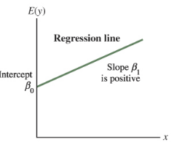
Simple Linear Regression Equation
Positive Linear Relationship

Slide 7
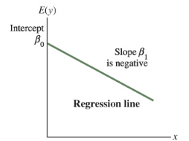
Simple Linear Regression Equation
Negative Linear Relationship

Slide 8
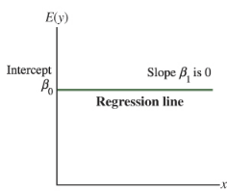
Simple Linear Regression Equation
No Relationship

Slide 9
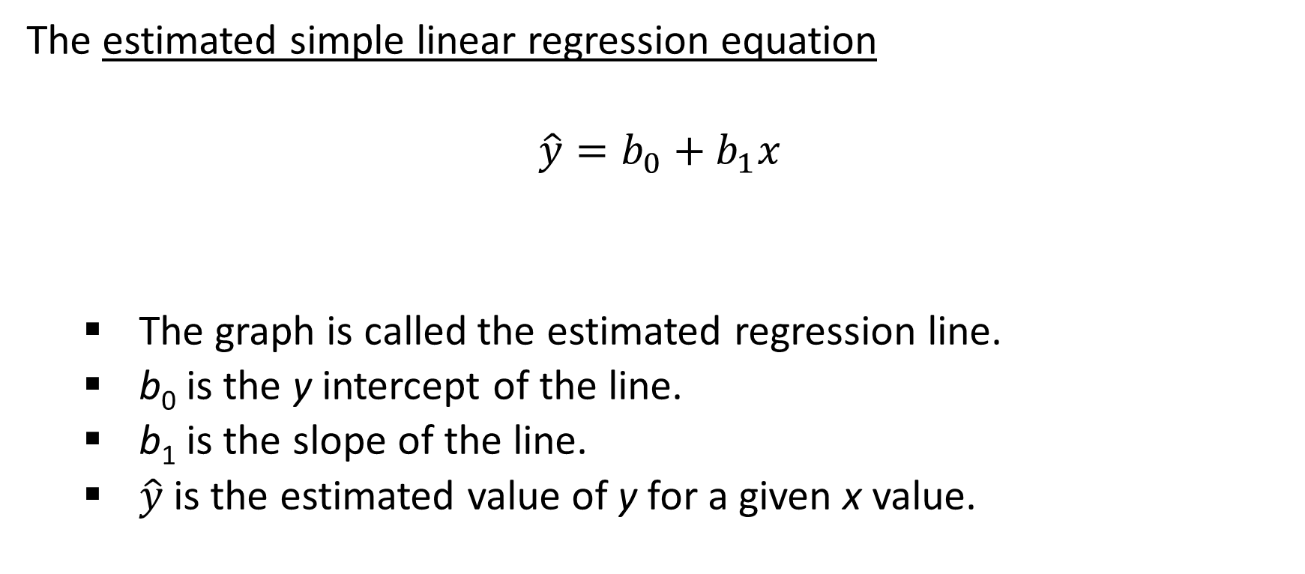
Estimated Simple Linear Regression Equation
The estimated simple linear regression equation
$$\hat{y}=b_{0}+b_{1}x$$
The graph is called the estimated regression line.
b₀ is the y intercept of the line.
b₁ is the slope of the line.
$\hat{y}$is the estimated value of y for a given x value.

Slide 10
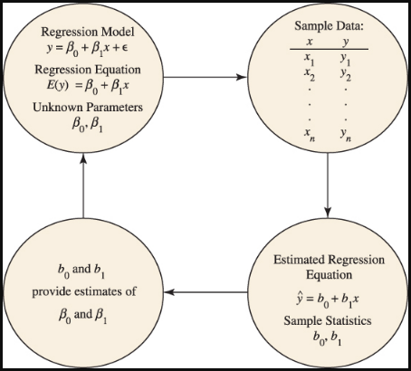
Estimation Process

Slide 11
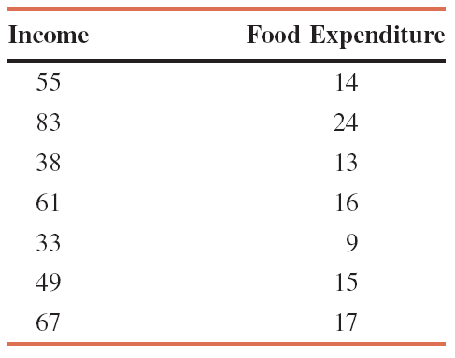
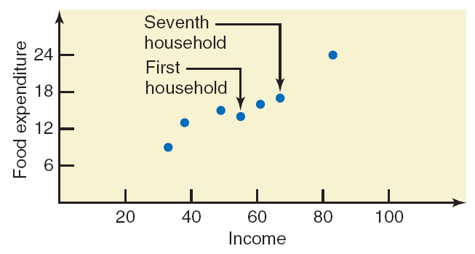
Example: Incomes (in hundreds of dollars) and Food Expenditures of Seven Households

Slide 12
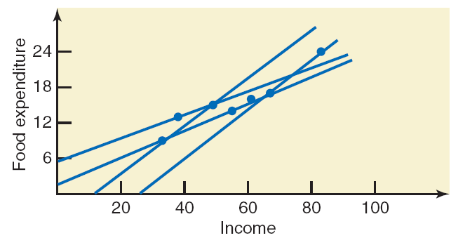
Example: Incomes (in hundreds of dollars) and Food Expenditures of Seven Households
In regression analysis, we try to find a line that best fits the points in the scatter diagram. Such a line provides a best possible description of the relationship between the dependent and independent variables.

Slide 13
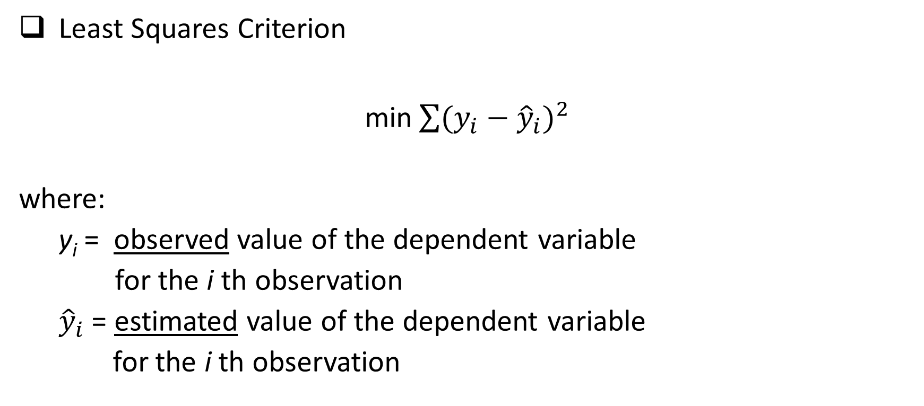
Least Squares Method
Least Squares Criterion
min$\sum{{(y_{i}−{\hat{y}}_{i})}^{2}}$
where:
y_{i} = observed value of the dependent variable
for the i th observation
${\hat{y}}_{i}$ = estimated value of the dependent variable
for the i th observation

Slide 14
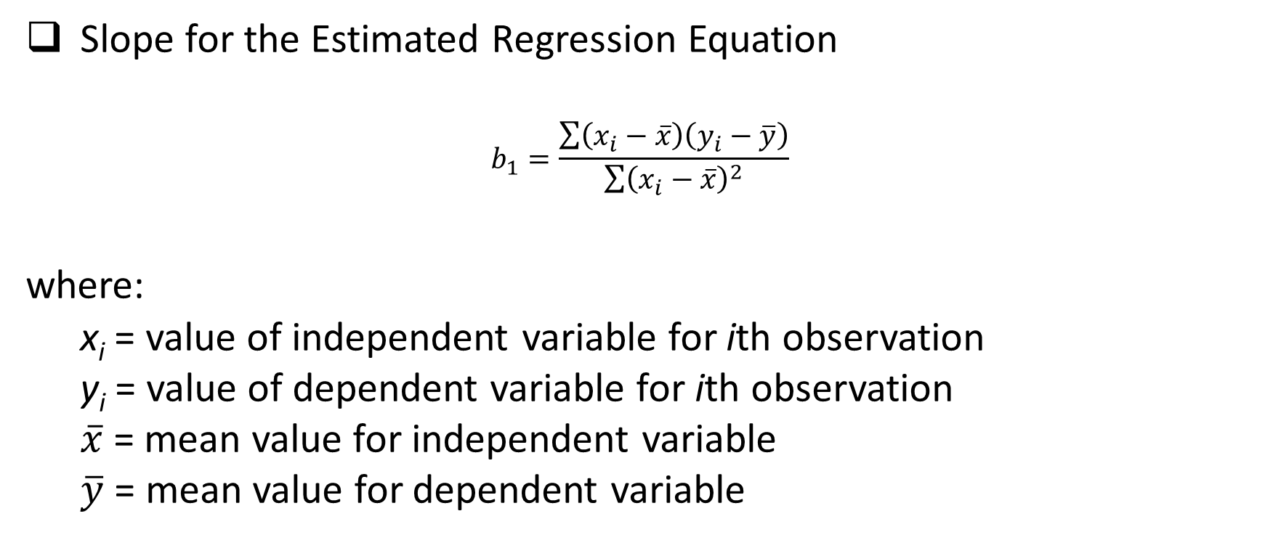
Least Squares Method
Slope for the Estimated Regression Equation
$$b_{1}=\frac{\sum{\left(x_{i}−\overline{x}\right)\left(y_{i}−\overline{y}\right)}}{\sum{{\left(x_{i}−\overline{x}\right)}^{2}}}$$
where:
x_{i} = value of independent variable for ith observation
y_{i} = value of dependent variable for ith observation
$\overline{x}$= mean value for independent variable
$\overline{y}$ = mean value for dependent variable

Slide 15

Least Squares Method
y-Intercept for the Estimated Regression Equation
$$b_{0}=\overline{y}−b_{1}\overline{x}$$

Slide 16
Simple Linear Regression
Example: Armand’s Pizza Parlor Restaurants
Data was collected from a sample of 10 Armand’s Pizza Parlor Restaurants near college campuses. For the ith observation or restaurant in the sample, x_{i} is the size of the student population and y_{i} is the quarterly sales.

Slide 17
Simple Linear Regression
Example: Armand’s Pizza Parlor Restaurants
Restaurant | Student population (1000s) | Quarterly sales ($1000s)
1 | 2 | 58
2 | 6 | 105
3 | 8 | 88
4 | 8 | 118
5 | 12 | 117
6 | 16 | 137
7 | 20 | 157
8 | 20 | 169
9 | 22 | 149
10 | 26 | 202

Slide 18
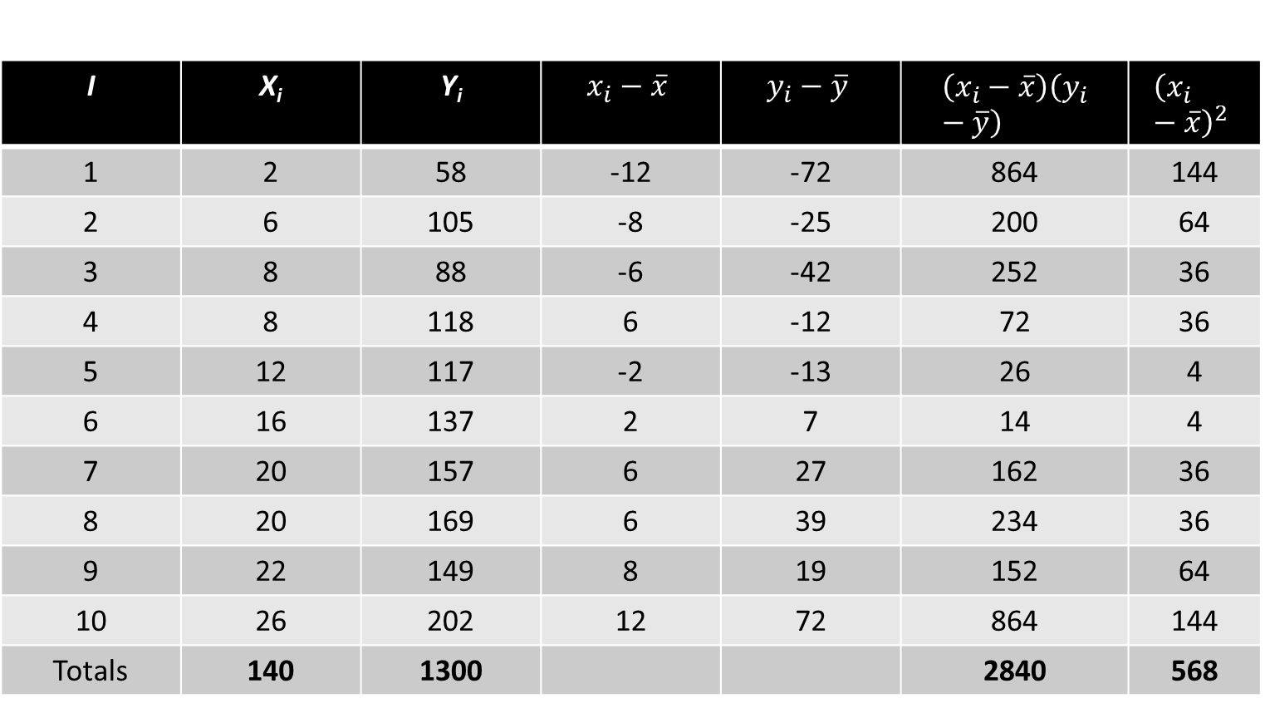
Simple Linear Regression
I | X_{i} | Y_{i} | $$x_{i}−\overline{x}$$ | $$y_{i}−\overline{y}$$ | $$\left(x_{i}−\overline{x}\right)\left(y_{i}−\overline{y}\right)$$ | $${\left(x_{i}−\overline{x}\right)}^{2}$$
1 | 2 | 58 | -12 | -72 | 864 | 144
2 | 6 | 105 | -8 | -25 | 200 | 64
3 | 8 | 88 | -6 | -42 | 252 | 36
4 | 8 | 118 | 6 | -12 | 72 | 36
5 | 12 | 117 | -2 | -13 | 26 | 4
6 | 16 | 137 | 2 | 7 | 14 | 4
7 | 20 | 157 | 6 | 27 | 162 | 36
8 | 20 | 169 | 6 | 39 | 234 | 36
9 | 22 | 149 | 8 | 19 | 152 | 64
10 | 26 | 202 | 12 | 72 | 864 | 144
Totals | 140 | 1300 |  |  | 2840 | 568
Example:
Armand’s
Pizza Parlor
Restaurants

Slide 19
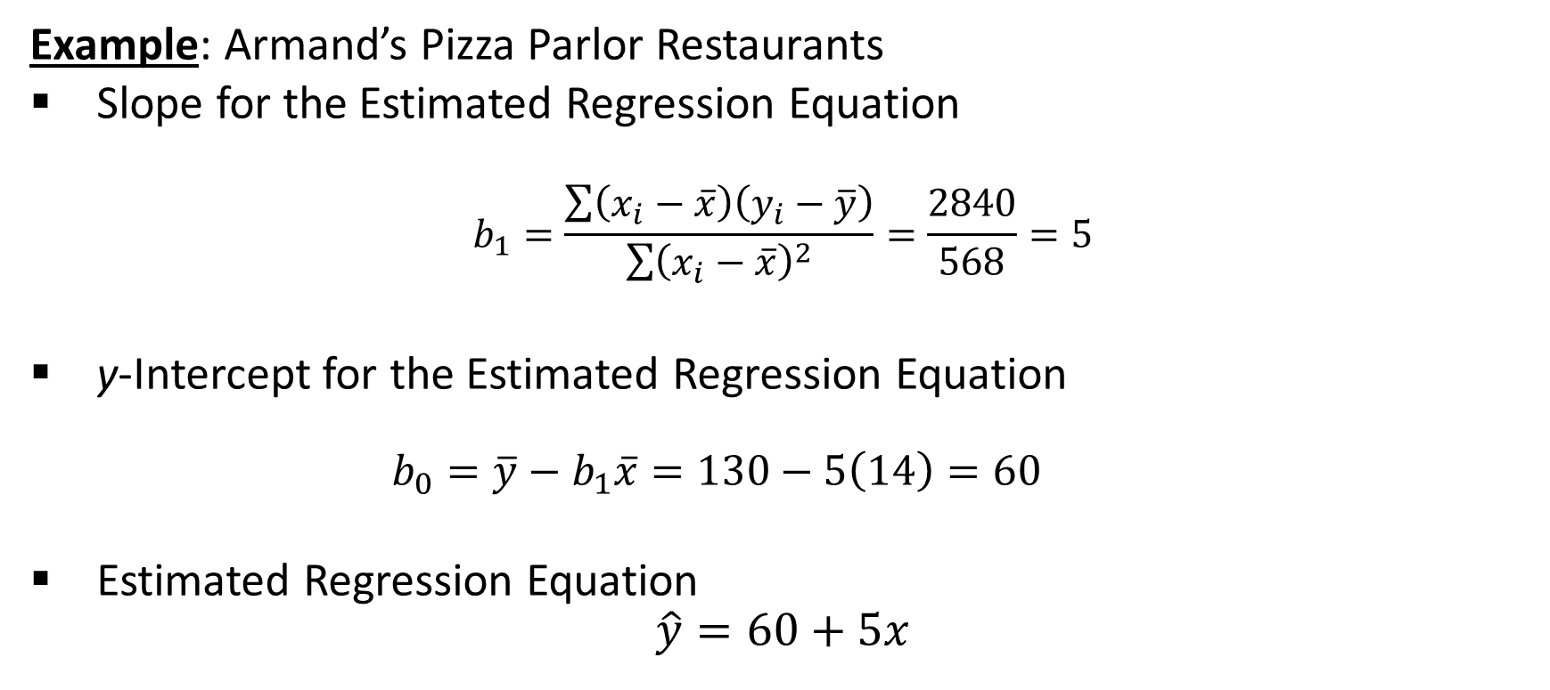
Simple Linear Regression
Example: Armand’s Pizza Parlor Restaurants
Slope for the Estimated Regression Equation
$$b_{1}=\frac{\sum{\left(x_{i}−\overline{x}\right)\left(y_{i}−\overline{y}\right)}}{\sum{{\left(x_{i}−\overline{x}\right)}^{2}}}=\frac{2840}{568}=5$$
y-Intercept for the Estimated Regression Equation
$$b_{0}=\overline{y}−b_{1}\overline{x}=130−5\left(14\right)=60$$
Estimated Regression Equation
$$\hat{y}=60+5x$$

Slide 20
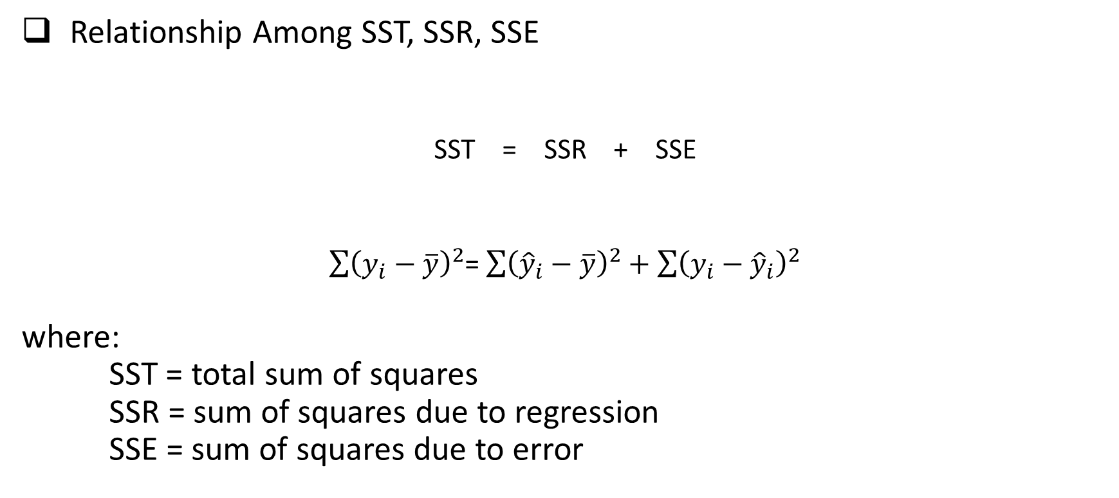
Coefficient of Determination
Relationship Among SST, SSR, SSE
SST = SSR + SSE
$\sum{{\left(y_{i}−\overline{y}\right)}^{2}}$= $\sum{{\left({\hat{y}}_{i}−\overline{y}\right)}^{2}+\sum{{\left(y_{i}−{\hat{y}}_{i}\right)}^{2}}}$
where:
SST = total sum of squares
SSR = sum of squares due to regression
SSE = sum of squares due to error

Slide 21
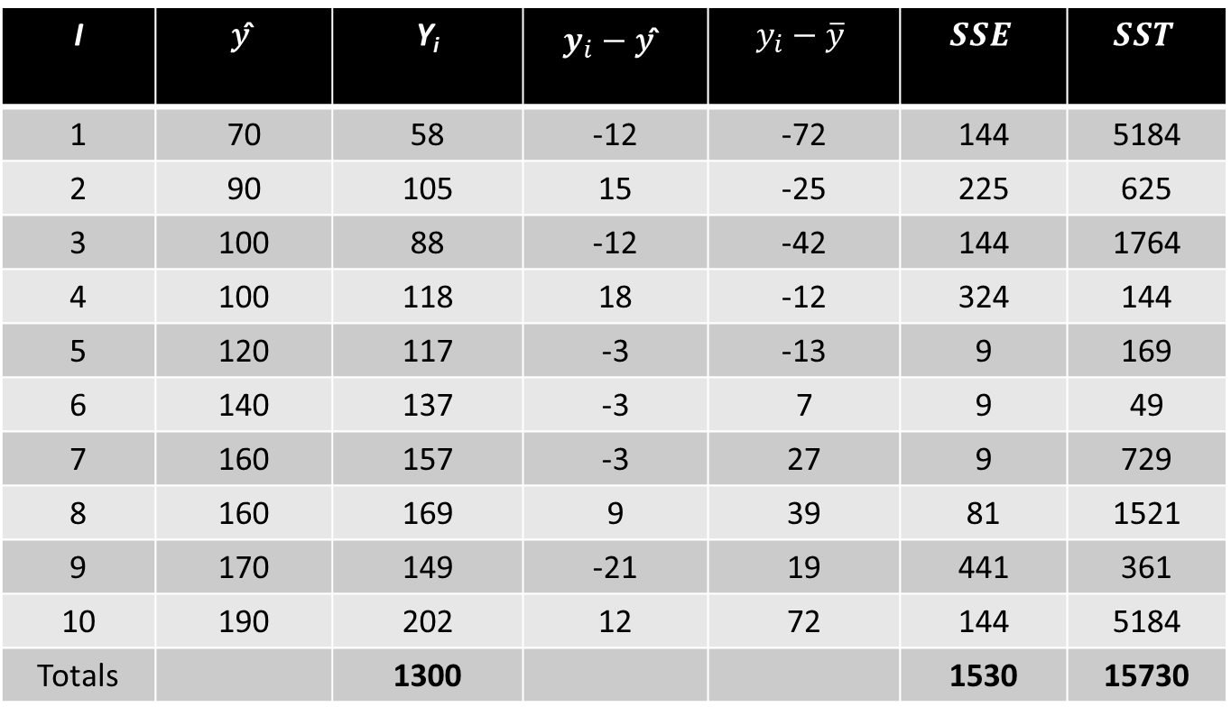
Coefficient of Determination
I | 𝑦 ̂ | Y_{i} | $$y_{i}−\text{y}\text{ ̂}$$ | $$y_{i}−\overline{y}$$ | $$SSE$$ | $$SST$$
1 | 70 | 58 | -12 | -72 | 144 | 5184
2 | 90 | 105 | 15 | -25 | 225 | 625
3 | 100 | 88 | -12 | -42 | 144 | 1764
4 | 100 | 118 | 18 | -12 | 324 | 144
5 | 120 | 117 | -3 | -13 | 9 | 169
6 | 140 | 137 | -3 | 7 | 9 | 49
7 | 160 | 157 | -3 | 27 | 9 | 729
8 | 160 | 169 | 9 | 39 | 81 | 1521
9 | 170 | 149 | -21 | 19 | 441 | 361
10 | 190 | 202 | 12 | 72 | 144 | 5184
Totals |  | 1300 |  |  | 1530 | 15730

Slide 22
Coefficient of Determination
The coefficient of determination is:
r² = SSR/SST
where:
SSR = sum of squares due to regression
SST = total sum of squares

Slide 23
Coefficient of Determination
Example: Armand’s Pizza Parlor Restaurants
r² = SSR/SST = 14,200/15,730 = .9027
The regression relationship is very strong; 90.27% of the variability in the sales can be explained by the linear relationship between the size of the student population and sales.

Slide 24

Sample Correlation Coefficient
$$r_{xy}=(sign of b_{1})\sqrt{Coefficient of Determination}$$
$$r_{xy}=(sign of b_{1}) \sqrt{r^{2}}$$
where:
b₁ = the slope of the estimated regression equation
$$\hat{y}=b_{0}+b_{1}x$$

Slide 25

Sample Correlation Coefficient
Example: Armand’s Pizza Parlor Restaurants
$$r_{xy}=(sign of b_{1}) \sqrt{r^{2}}$$
The sign of b₁ in the equation $\hat{y} \text{= }\text{6}\text{0 + 5}\text{x} \text{is}\text{ "+"}.$
$$r_{xy}=+\sqrt{.9027}$$
r_{xy} = +.9051

Slide 26
End of Chapter 10

